Slide 1
Web Architecture, Tools, and Introduction to PHP
ITWA133

Slide 2
An introduction to PHP web programming
Objectives
To understand the history of PHP
To know the advantages of PHP as a server side scripting language
To know what are the software's needed in developing web application using PHP.
To run PHP application on a web browser.
To know the basic syntax of PHP for outputting to browser.
To know the datatypes that are available on PHP and on how these datatypes are being used.
To know some predefined type function for data manipulation.
To know the proper casting values of a given variables.

Slide 3

An introduction to PHP web programming
HISTORY
1994/1995 (PHP 1.0)
Developed by Rasmus Lerdorf
To know how many visitors were reading his online resume based on PERL/CGI script
Personal Home Page (PHP)
1997 (PHP 2.0)
PHP is based on C rather than PERL
Personal Home Page/Form Interpreter
1998 (PHP 3.0)
50,000 users were using PHP to enhance their Web pages
Developers joined Lerdorf
1999 (PHP 4.0)
With core developers Zeev Suraski and Andi Gutmans
PHP makes the most popular scripting language with morethan one million user base by Netcraff

Slide 4
An introduction to PHP web programming
HISTORY (Con’t.)
Hundreds of functions being added
Dubbed the Zend scripting engine
May 22, 2000 (PHP 4.0)
PHP: Hypertext Preprocessor (recursive acronym)
3.6 million domain PHP installed
Enterprise development
Improved resource handling (scalability)
Object-oriented support (Classes and Objects)
Native session-handling support (session)
Encryption (encryption algoritms)
ISAPI Support (for IIS)
Native COM/DOM (Windows applications)
Native Java Support: (binding to java objects)
PERL Compatible Regular Expressions
New features, power, and scalabilty

Slide 5
An introduction to PHP web programming
HISTORY (Con’t.)
PHP 5 (July 13, 2004)
Vastly improved object-oriented capabilities: OOP improvement
Try/catch exception handling
Improved XML and Web Services support (Simple XML Support, using SOAP)
Native support for SQLite
Installed on 19 million domains
54 percent on all Apache module
PHP 6 (2007 not yet released)
Unicode Support (Native Unicode support for multilingual applications
Security improvements
New language features and constructs (64-bit type integer, foreach looping)
http://en.wikipedia.org/wiki/PHP

Slide 6
An introduction to PHP web programming
HISTORY (Con’t.)
PHP Key categories
Practicality
PHP is a loosely type language (no explicitly create, typecast, or destroy a variable)
Power
More libraries and thousands of functions
Possibility
Native support is offered for more than 25 database products, including Adabas D, dBase, Empress, FilePro, FrontBase, Hyperwave, IBM DB2, Informix, Ingres, InterBase, mSQL, Microsoft SQL Server, MySQL, Oracle, Ovrimos, PostgreSQL, Solid, Sybase, Unix dbm, and Velocis.
Both structured and Object Oriented approach
Price
Free of charge

Slide 7


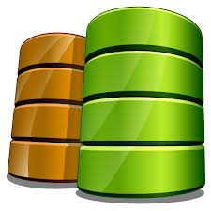
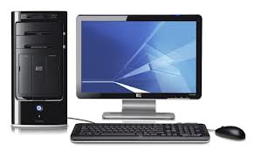

An introduction to PHP web programming
Web Architecture
Page Request
html
Internet
Page Request
html
scripts
database

Slide 8








An introduction to PHP web programming
Software Requirements
Operating System: Linux

Slide 9







An introduction to PHP web programming
Software Requirements
Operating System: Windows

Slide 10


An introduction to PHP web programming
Software Requirements
Operating System: Mac
Cheetah
Panther
Puma
Jaguar
Tiger
Leopard
Snow leopard
Lion

Slide 11










An introduction to PHP web programming
Software Requirements
Internet browser
Opera
Mozilla
Firefox
Internet
Explorer
Safari
Google
Chrome
Deepnet
Explorer
Rockmelt
Avant
Browser
Maxthon
SeaMonkey

Slide 12




An introduction to PHP web programming
Software Requirements
Web Server
Apache
Google Web Server (GWS)

Slide 13






An introduction to PHP web programming
Software Requirements
Server side scripting language
Java
(JavaServer Pages: JSP)
Active Server Pages
(ASP)
Ruby (Ruby on Rails)
Python
(Django)
PERL CGI

Slide 14






An introduction to PHP web programming
Software Requirements
Database
Oracle

Slide 15






An introduction to PHP web programming
Software Requirements
Code editor
Bluefish
Dreamweaver

Slide 16



An introduction to PHP web programming
Software Requirements
Other
CSS
HTML

Slide 17



An introduction to PHP web programming
Software Requirements
Other
Operating System
Windows 7 / Windows 8
Web Server
Apache
Language Script
PHP
Database
MySQL
Code Editor
Notepad++ / Eclipse / Netbeans / Dreamweaver
XAMPP / WAMP

Slide 18
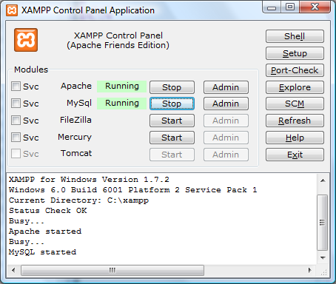
An introduction to PHP web programming
Running PHP Scripts
XAMPP
Download XAMPP
http://www.apachefriends.org/en/xampp.html
Install XAMPP
Run XAMPP Control
c:\xampp (by default)
Start the Apache and MySQL(for database) Service
Create a folder under c:\xampp\htdocs\ (by default)
Note: All php files must be save on that folder
Test PHP script sample file.
Open some internet browser
Type localhost/[folder name] (by default)
Select file from the directory list (if there’s

Slide 19
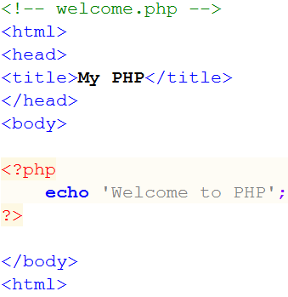
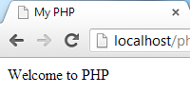
An introduction to PHP web programming
Running PHP Scripts
All php scripts must enclosed with
<?php … ?> (standard tag)
<? … ?> (short open tag)
<script language=“php”>
….
</script> (script tag)
<% … %> (asp style tag)
OUTPUT:

Slide 20

An introduction to PHP web programming
Running PHP Scripts
opening tag for php script
Statement terminator
echo – is a language construct that use to output one or more string.
print – is a function also use for outputting strings.
closing tag for php script

Slide 21
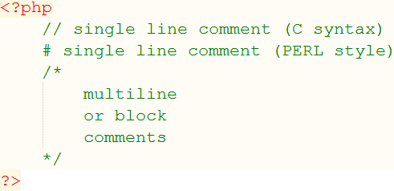
An introduction to PHP web programming
PHP Comments

Slide 22
An introduction to PHP web programming
PHP Variables
Variables are used as a container for values that can be used and manipulate PHP scripts.
Variables in PHP must begin with a $ symbol.
Variable might contain a string, numbers, arrays and objects.
Setting the identifier for a variable must follow some rules.
First character can be ‘_’ or a letter.
It can only contain alpha-numeric characters and underscore (a-z,A-Z,0-9,_).
Don’t use white space in naming a variable.
Variables in PHP is not explicitly declared
Variables are case sensitive
Example
$age, $firstName, $totalSalary, $_myValue, $str1, $tmp01

Slide 23
An introduction to PHP web programming
Using ‘ ‘ (pair single quote), “ “ (pair double quotes) and . (dot character) PHP
Strings inside the ‘ and ‘ are interpreted as literal strings
To display a ‘ character (single quote) as string use the escape character \ (backslash).
Strings inside the “ and “ are interpreted as literal strings with some exceptions
$ inside “ and “ are interpreted as variables thus it will display the value rather than the string that starts with $.
To display the string that starts with $ and to display the double quote as string use the escape character \ (backslash).
To concatenate string values use the . (dot or period) character thus “abc“.”def” yields to a value “abcdef”

Slide 24
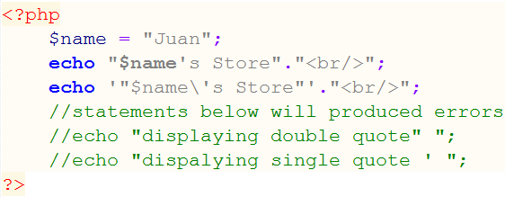
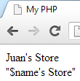
An introduction to PHP web programming
Using ‘ ‘ (pair single quote), “ “ (pair double quotes) and . (dot character) PHP
Example:
Output:

Slide 25
An introduction to PHP web programming
Outputting Data
echo syntax
void echo(string argument1[,…string argumentN]
print syntax
int print(argument)
printf syntax
boolean printf(string format [, mixed args])

Slide 26
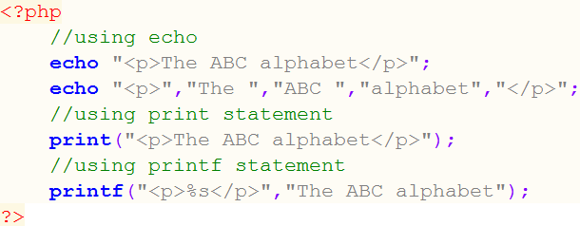
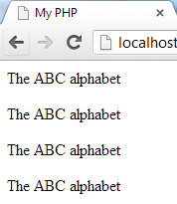
An introduction to PHP web programming
Outputting Data
Example:
Output:

Slide 27
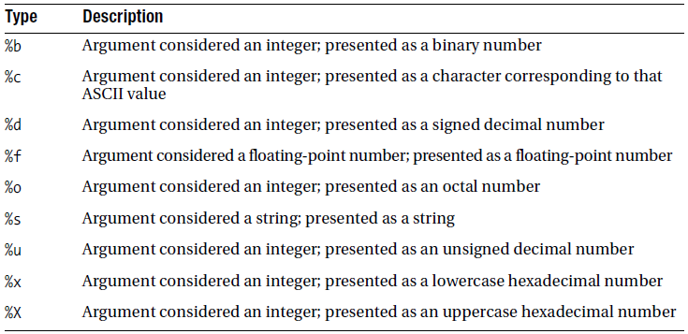
An introduction to PHP web programming
Commonly Used Type Specifiers for printf function
Beginning PHP and MySQL 3rd Edition by: W. Jason Gilmore pp.100

Slide 28
An introduction to PHP web programming
PHP Datatypes
Datatypes
is the generic name assigned to any data sharing a common set of characteristics.
Scalar Datatypes
Capable of containing a single item of information
(Boolean, Integer, Float (float, double or real numbers), String)
Compound Datatypes
allow for multiple items of the same type to be aggregated under a single representative entity.
(Array and Objects)

Slide 29
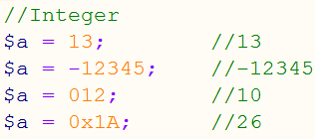
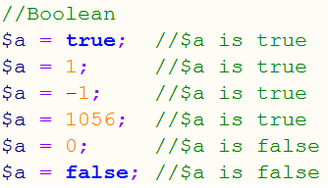
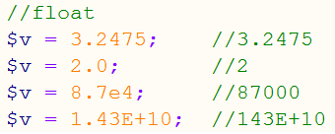
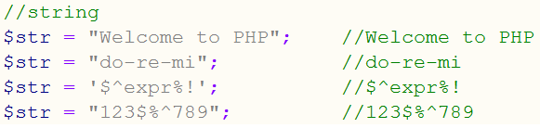
An introduction to PHP web programming
Scalar Datatypes
Eample:

Slide 30
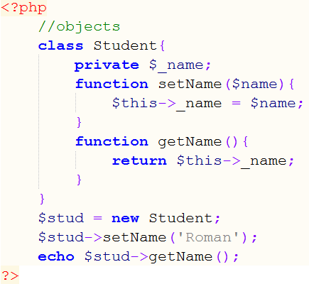
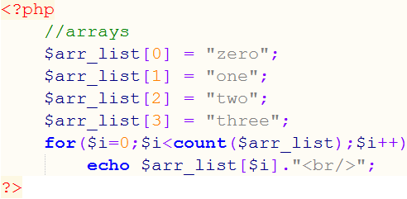
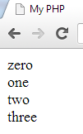

An introduction to PHP web programming
Compound Datatypes
Example:
Output:
Output:

Slide 31
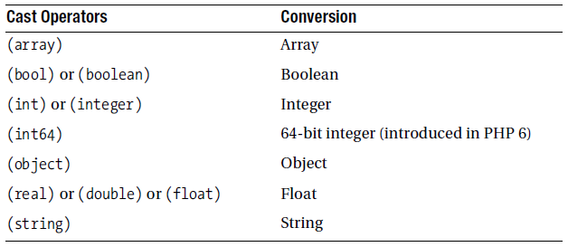
An introduction to PHP web programming
PHP Type Casting Operators
Beginning PHP and MySQL 3rd Edition by: W. Jason Gilmore pp.105

Slide 32
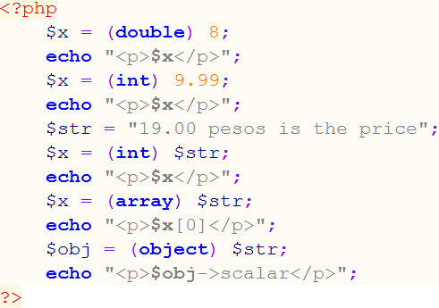
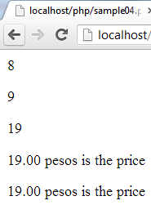
An introduction to PHP web programming
PHP Type Casting Operators
Example:
Output:

Slide 33
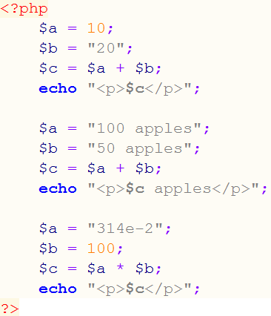

An introduction to PHP web programming
PHP Type Juggling
Example:
Output:

Slide 34
An introduction to PHP web programming
Predefined Type Functions
gettype() function
returns the type of the variable. Possible return values are integer, double, boolean, string, array, object, resource, unknown types.
prototype:
string gettype(mixed var)
settype() function
converts a given variable to a specific type.
prototype:
boolean settype(mixed var, string type)
Predefined Type Identifier Functions
is_array(), is_bool(), is_float(), is_integer(), is_null(), is_numeric(), is_object(), is_resource(), is_scalar(), and is_string()

Slide 35
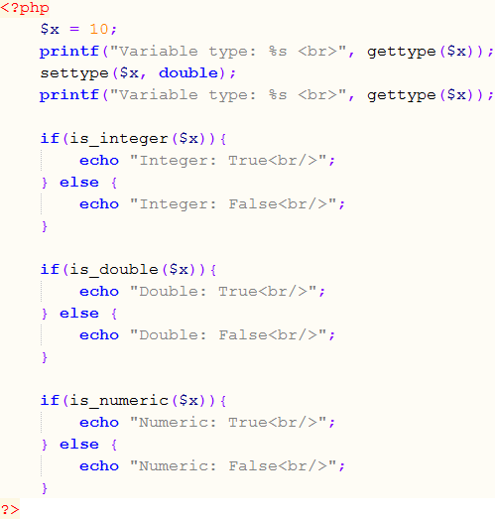
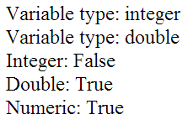
An introduction to PHP web programming
Type Functions
Example:
Output:

Slide 36
An introduction to PHP web programming
Summary
PHP was developed originally by Rasmus Lerdorf
Seev Suraski and Andi Gutsman were the one who contribute most in PHP development.
PHP key categories are practicality, power, possibility, and price.
PHP is a embedded language that is commonly embedded on HTML
PHP is a server-side scripting language that runs its application on a Web server.
Much of the PHP syntax were derive from C programming Language.
You can integrate database easily in PHP.
Standard PHP script are enclosed by <?php and ?> tags.
Each statement in PHP must be terminated with a semi-colon(;).
All variable in PHP must have a dollar ($) character before its identifier.

Slide 37
An introduction to PHP web programming
Summary (Continue)
PHP variables are not explicitly declared.
You can use echo, print, or printf function for outputting strings to internet browser.
You can enclosed string using a pair of single quote or pair of double quote.
String inside a pair of single quote interpreted as literal except for the single quote itself.
String inside a pair of double quote interpreted as literal with some exception like using dollar character.
To explicitly display the character on the internet browser use backslash (\) character like \$, \’, \” and etc.
Datatypes in PHP can be categorized as scalar or compound datatypes.
You can explicitly change the type of a variable in PHP.
PHP support some predefined type function that can be used in manipulating type variables.

